Slide 1
SAP BTP Architect Training
Day 8
Anubhav Oberoy
www.AnubhavTrainings.com
Follow excellence with sheer passion

Slide 2


DISCLAIMER
The training content and delivery of this presentation is confidential, and cannot be recorded, or copied and distributed to any third party, without the written consent of Anubhav Trainings

Slide 3
Agenda – Day 8
01
04
Cloud Security and Role Management
Introduction to Extensibility
02
05
CI/CD Service in BTP
Implementation types
03
06
Cloud Transport management
Unmanaged Implementation

Slide 4

































Slide 5































Slide 6












Slide 7




























Slide 8



























Build Workzone is new name of launchpad

Slide 9
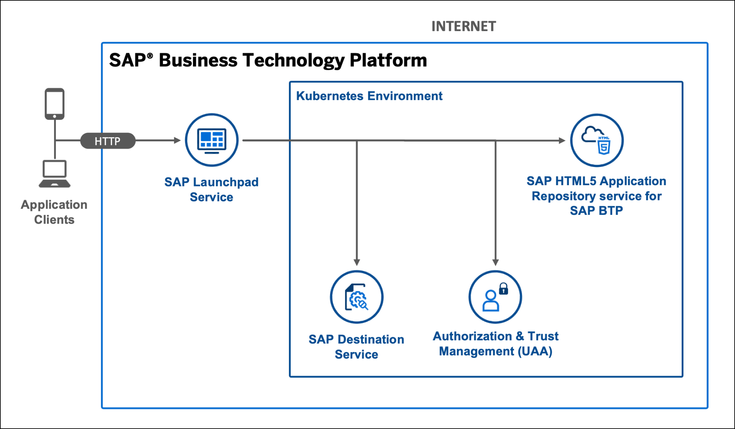
Hands on Serverless SAP Fiori Extension App

Slide 10

Question
Currently you are testing the Fiori App by using the standard preview option in eclipse tool. Will our end user have the ability and skill to open eclipse tool, go to package and search BIMP and then open preview and that too in production system.
Business Application Studio – It is a multi cloud development tool which allows developers to build, test, package, deploy, and manage end to end Fiori applications.
SAP build work zone (aka cFLP in BTP) – it helps us to configure a site called Fiori launchpad in the cloud. All the Fiori Apps which you build in BTP will be accessed via this build workzone from end user. End user will get single URL, which contains the tiles for all our apps deployed in BTP.
Continuous Integration Service – When a developer change the application, and push to central repository like git, the CI service will automatically build and deploy our app.
Note:
All the Fiori apps which we create in BTP will be called MTA – Multi target application, they are deployed with mta.yml file. Which will contain the configuration for the Fiori App.
In SAP BTP, there is a storage space called html-5-repository where the BTP will store our Fiori apps.
When we deploy our app, there is html5-deployer which will take our app from BAS tool and deployes it to the HTML5 Repository (Design time)
When we run the app, there is a service called html5-rt (runtime) service which will load our app from the repository in the build workzone.
Apart from that the application will contain a connectivity service to communicate with our abap on cloud system.
And a destination service which will read the destination (RFC) of AOC system to access data in Fiori.
www.anubhavtrainings.com

Slide 11

























Slide 12
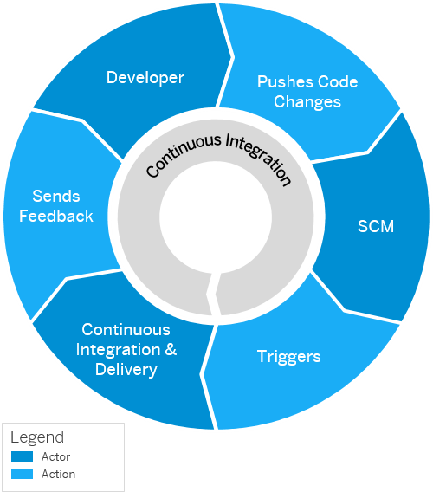
Continuous Integration and Delivery (CI/CD)
Configure and run predefined continuous integration and delivery (CI/CD) pipelines that automatically build, test, and deploy your code changes to speed up your development and delivery cycles.
Continuous integration (CI) describes a software development process, in which various team members integrate their contributions frequently into a single main line. Before each integration, the changes are verified through builds and automated testing. Thereby, you can detect errors as quickly as possible and prevent integration problems before completing the development.
The continuous delivery (CD) concept expands on the one of continuous integration. It adds the aspect that any change that has successfully passed the tests is immediately ready to be deployed to production, both from a technical and a qualitative point of view.

Slide 13
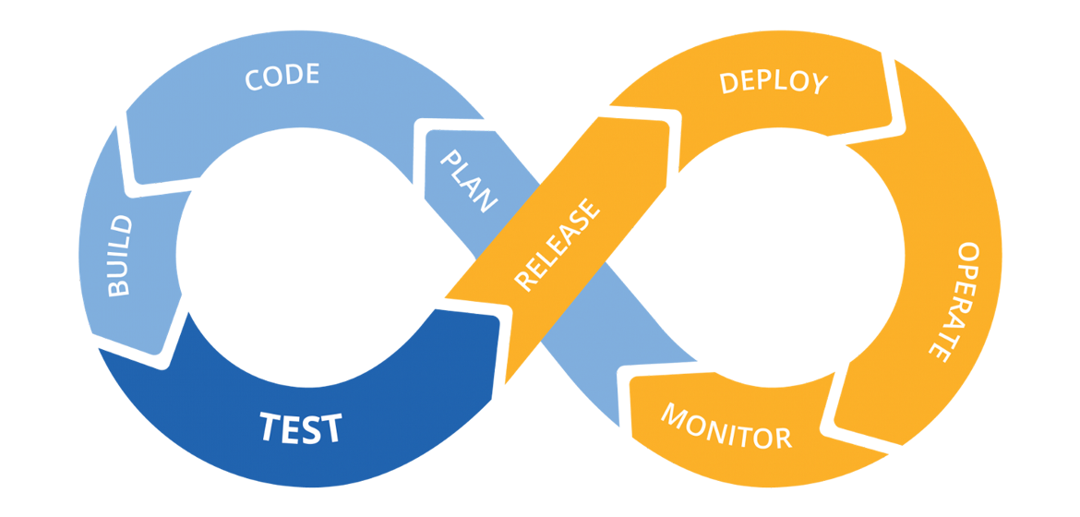
Hands on: Continuous Integration

Slide 14
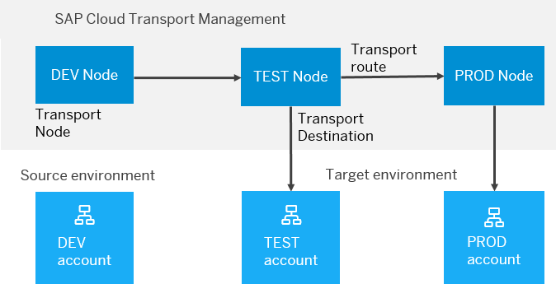
BTP Cloud Transport Management
SAP Cloud Transport Management service lets you manage software deliverables between accounts of different environments (such as Neo and Cloud Foundry), by transporting them across various runtimes. This includes application artifacts as well as their respective application-specific content.
SAP Cloud Transport Management service adds transparency to the audit trail of changes so that you get information about who performed which changes in your production environment, and when they did it. At the same time, the service enables a separation of concerns: For example, a developer of an application or of SAP Cloud content artifacts can trigger the transport of changes in a development subaccount, while the resulting import into the test, and production subaccount is handled by a central operations team.

Slide 15

Hands on SAP BTP Cloud Transport

Slide 16
What is Extensibility
Extensibility is a key capability of SAP ECC and SAP S/4HANA. It enables customers to create a competitive advantage by customizing their business processes and allows partners to enrich core ECC or S/4HANA with tailor-made solutions
During the last decades SAP’s on-premise customers and partners have mainly used classic ABAP extensibility to extend their ERP solution. Classic extensibility allows ABAP developers to use and even to modify all SAP objects. Although, classic extensibility is very powerful and flexible, it is no longer a good option in today’s cloud world.
In-lined with cloud strategy, SAP S/4HANA provides a new upgrade-stable cloud extensibility model that clearly separates SAP code and extensions via public SAP APIs and SAP extension points.

Slide 17
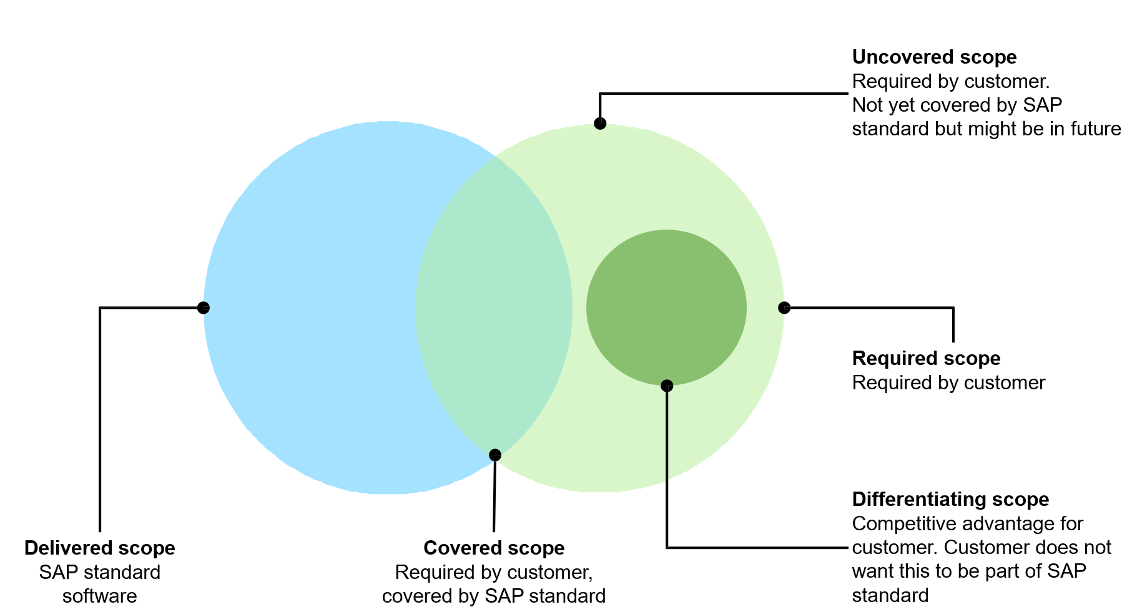
What is Extension?
We all know that standard SAP software doesn’t cover the scope of all the company business processes. There is always a need for a new app, a new report, or a new functionality. SAP partners and customers have been traditionally building extensions on SAP ECC system using ABAP code. However, with SAP S/4HANA and customer’s digital transformation journey towards cloud, we need a more robust yet loosely coupled extensibility model.

Slide 18
Classic Extensions and Challenges
Traditionally, SAP partners and customers have been using classic ABAP extensibility to extend their ERP solution.
Classic Extensibility (aka classic ABAP custom development) in SAP S/4HANA (or in SAP ECC):
Allows you to use classic development tools and techniques (e.g., transaction SE80, Eclipse IDE, BAdIs etc.)
Very rich of features and functions.
Extremely flexible and even allows you to modify SAP code itself.
Although, being very powerful, flexible, and popular, classic extensibility has some major drawbacks.
One of them is High Upgrade Efforts!
The missing clear interface between SAP code and extensions might lead to issues in the extensions during upgrades. As a result, upgrades require high planning, regression test, and adaption efforts, which is one of the reasons why customers delay upgrades.
Example:
You have used an SAP object that is not whitelisted by SAP in your extension. After an upgrade the used SAP Object has been changed or deleted. Now you will have to adjust the extension thus upgrade is delayed.

Slide 19
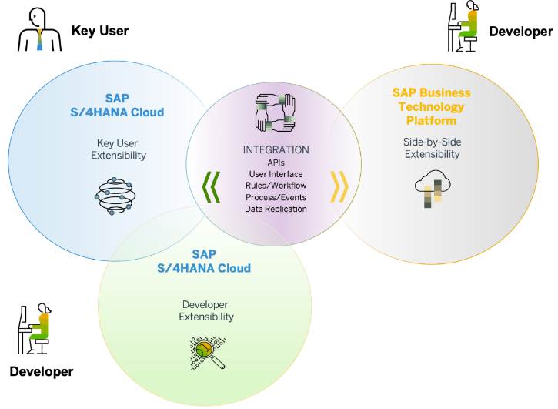
Clean Core and Benefits
Clean core is an extension methodology in which
Extensions are kept strictly separate from the SAP application.
Extensions access SAP business objects only through well defined, upgrade-stable interfaces
By following clean core paradigm, you make sure that
Extensions do not break an upgrade and upgrades do not break an extension.
Extensions do not create a problem when you migrate from SAP S/4HANA on-Premise to SAP S/4HANA Cloud
SAP’s rationale behind the “clean core” paradigm is simple – Allow customers to extend their SAP S/4HANA software while making the software updates eventually non-events.
Clean core paradigm is the back-bone of S/4HANA new extensibility model. It provides following benefits
Reduce TCO
Make upgrades non-events from a custom code point of view
Reduce test efforts for business users
Reduce adaption efforts for developers
IT service providers can offer upgrade projects at a fixed price
Speed and Innovation
Absorb innovation delivered by SAP at a faster rate
React fast on changing business requirements
Be cloud ready
Lay the foundation today to move to the cloud from a custom extension perspective

Slide 20
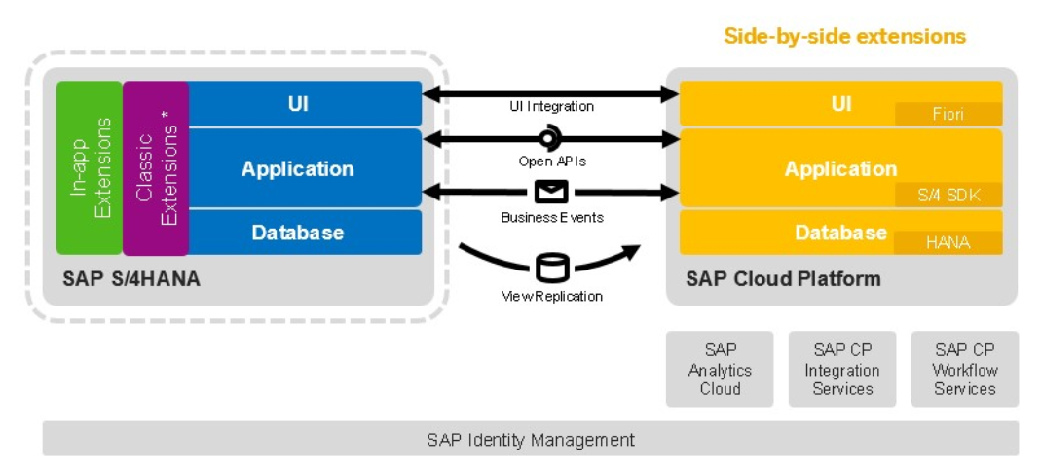
Approaches for Side-by-Side Extension

Slide 21
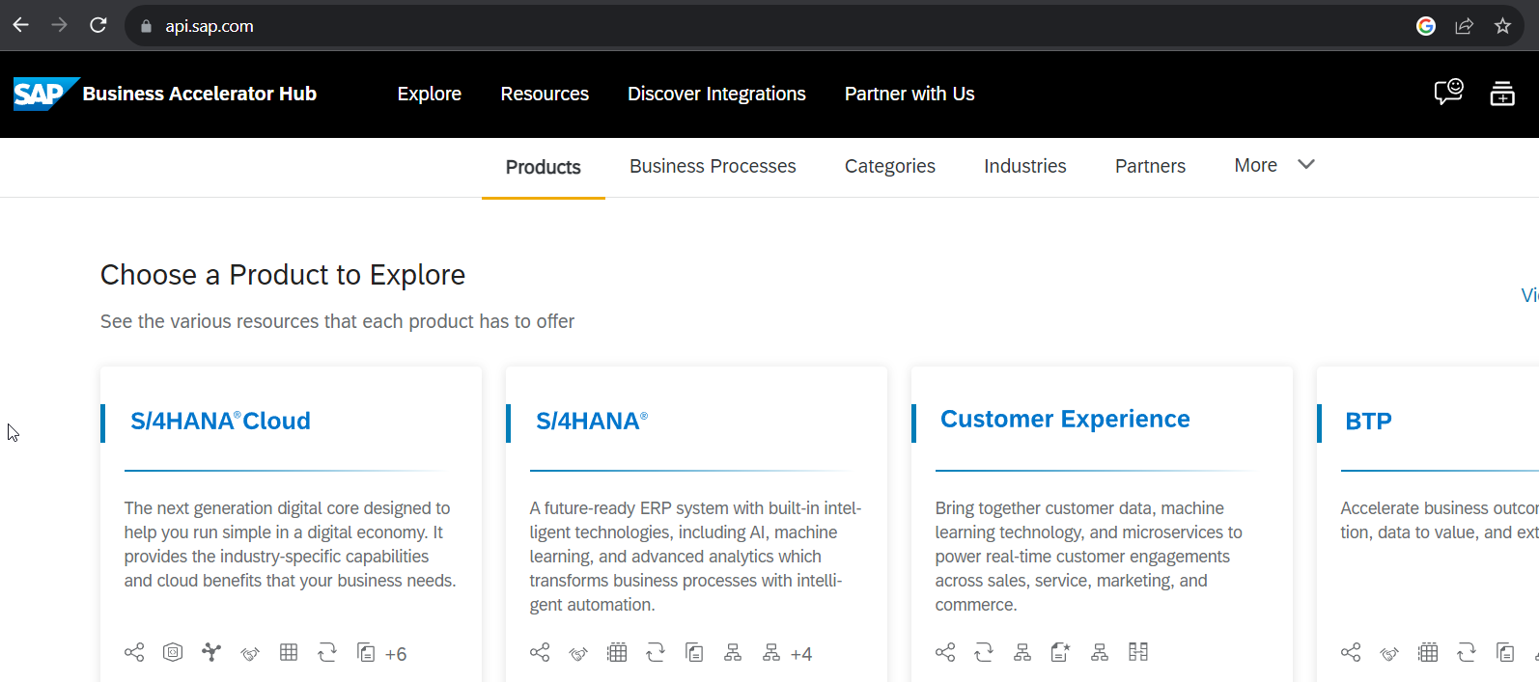
SAP Business API HUB
The SAP API Business Hub is a web application hosted by SAP to discover, explore, and test SAP and partner APIs (application programming interfaces). API’s enable to build extensions or process integrations.
Access
The SAP API Business Hub is a public website https://api.sap.com that anyone can access. You might however need to login to experience some of our features.
What are APIs?
An API is a programming object that enables developers to use or extend the provided functionality in a service. With API’s you can extend solutions, integrate them with other solutions, or build new apps.
Different API types
You will find REST, SOAP, and OData APIs on the SAP API Business Hub. A description for the different API types you can find here.

Slide 22
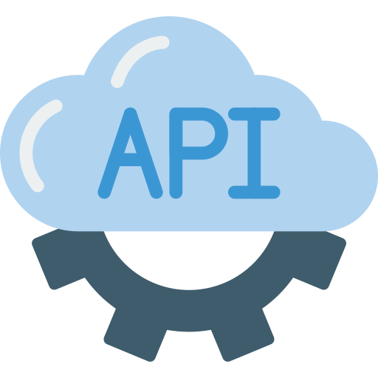
Hands-on : Find SAP Sales Order API in APIHUB & Test in POSTMAN

Slide 23
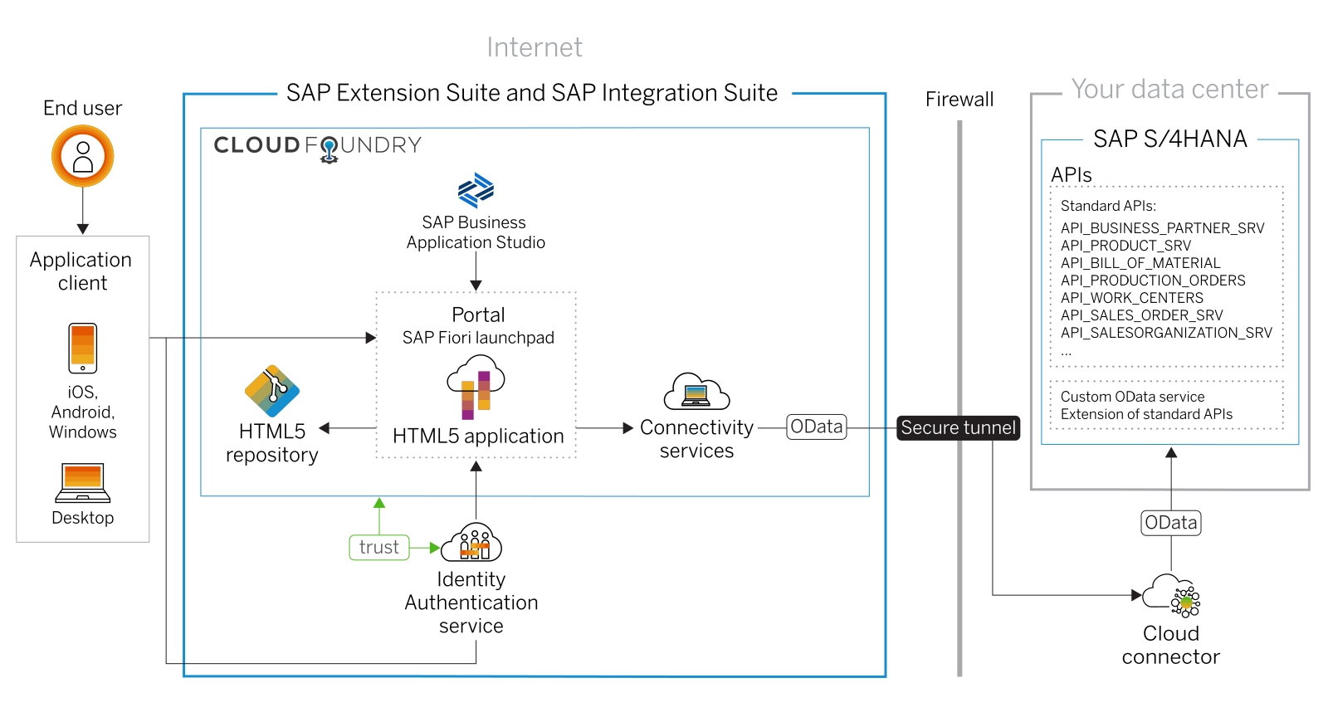
Scenario 1: UI Extensibility

Slide 24
Hands on: Create Display like App for Sales Order
Enabling an OData API on SAP S/4HANA
Setting up SAP Cloud Connector and S/4HANA for principal propagation
Setting up an SAP BTP BAS Subscription
Developing of a simple Fiori Application with the SAP Business Application Studio
Deploying the application to the HTLM5 repository service
Integrating he application into the Launchpad service
Destination service – to read the destination from SAP BTP at runtime for the purpose of connection
Connectivity service – once the destination is read, it will use connectivity service to connect to our oData source
HTML5 deployer – this will be used to deploy our app to HTML5 repository.
HTML5 Repo Runtime – Will load the Fiori app when requested at runtime.
Fiori launchpad service – which displays Fiori apps as a tile.

Slide 25
Scenario 2:
Own Fiori App
SAP or Non SAP API OData which we want to reuse
Android App
SAP UI5 App
CAPM App
Middleware
Data manipulation, enrichment, Security, automation, movement, proxy
HANA

Slide 26
Hands on: Initialize CAPM Extension
Create a new cap project with cds init
Drag drop edmx file downloaded from API hub and perform cds import PATH_OF_EDMX
Add a new CatalogService.cds and CatalogService.js
S4HANA cloud sdk is SAP’s portfolio of all the type safe API (node modules) to communicate to SAP APIs.
Install the node module @sap/cloud-sdk-vdm-sales-order-service
Add the configuration to test our api locally – credentials

Slide 27
Hands on: Initialize CAPM Extension
Create a new folder and initialize cap project using cds init
Go inside project and install following modules
2.1 Cloud Foundry Security - @sap/xssec, @sap/xsenv, passport
2.2 OData V2 @sap/cds-odata-v2-adapter-proxy
2.3 Serving odata v2 over cloud sdk - @sap-cloud-sdk/odata-v2
2.4 To generate the service code in node js, install cloud sdk generator module using @sap-cloud-sdk/generator
3. Create a new folder service-spec, and cds watch, after that drag drop the edmx file of our service to the folder. It will create external folder
4. Generate the JS code to automatically get all the calls which will call the service
npx generate-odata-client --input ./service-spec --outputDir ./srv/sales-order-api
Give the folder path, not the edmx file path
5. Define the service definition in CatalogService.cds file by referencing from csn file generated based on SAP OData
6. Define the service implementation CatalogService.js file and write the code to use the generated type script modules which will act like bridge to communicate to our SAP OData Business API.
7. Generate a Fiori application using free style with local cap project.

Slide 28
Hands on Cloud Extension
8. Replace hardcoded credentials with destination
9. Create a destination service and maintain destination with name S4HANA because the same we used in our code.
10. Create mta.yaml file for deployment
11. Add the modules, both srv and ui module.
12. Add Resources as destination and xsuaa. Maintain the xs-security.json file
13. Get the package json in app folder from ui project, Add the app router module @sap/approuter and include start script.
14. xs-app.json file for routing paths
15. Push the code to the github
16. You can pull the app in BAS tool, Right click on mta.yaml and build MTA Archieve
17. Once done, right click and deploy MTA_Archieve to SAP BTP

Slide 36

What We Did
Let’s Summarize

Slide 37

www.anubhavtrainings.com
Thank You
End of Day 8

Slide 38


We’re committed to empower you to be
#FutureReady
through powerful training solutions.
We build the workforce of the future.
280+
Corporate Clients
80,000+
Learners Trained
28000+
Learners Placed
FREE WEBINARS
Sign up for free webinars with industry experts every fortnight!
Enroll Now!
Contact us today!
https://anubhavtrainings.com

